Slide 1
Twitter U.S. Airline Sentiment Analysis using Keras and RNNs

Slide 2
Introduction
Sentiment analysis is a type of natural language processing problem that determines the sentiment or emotion of a piece of text.
For example, an algorithm could be constructed to classify whether a product’s review was positive, neutral, or negative.
Natural language processing (NLP) is a field of artificial intelligence that involves computers understanding and processing human language. The goal is often to derive meaning from text.

Slide 3
Data
Our dataset is called “Twitter US Airline Sentiment” which was downloaded from Kaggle as a csv file. Its original source was from Crowdflower’s Data for Everyone library. Tweets were scraped from Twitter in February 2015 about each major US airline.
There are 14,640 rows and 15 columns. The included features are: tweet id, sentiment, sentiment confidence score, negative reason, negative reason confidence, airline, sentiment gold, name, retweet count, tweet text, tweet coordinates, time of tweet, date of tweet, tweet location, and user time zone.

Slide 4
Recurrent Neural Network
Unlike feedforward networks that process each input individually and independently, a RNN creates loops between each node in the neural network. This makes it particularly good for sequential data, such as text.
It is able to process sequences and create a state which contains information about what the network has seen so far. This is why RNNs are useful for natural language processing, because sentences are decoded word-by-word while keeping memory of the words that came beforehand to give better context for understanding.
A RNN allows information from a previous output to be fed as input into the current state. Simply put, we can use previous information to help make a current decision.

Slide 5
LSTM
Simple RNNs suffer from the vanishing gradient problem which occurs when information from earlier layers disappear as the network becomes deeper.
A LSTM algorithm was created to avoid this problem by allowing the neural network to carry information across multiple time steps. This means it can save important information for later use, preventing gradients from vanishing during the process
Additionally, a LSTM cell can determine what information to remove as well. Therefore, it can learn to recognize an important input and store it for the future while removing unnecessary information.

Slide 6
Bidirectional RNNs
In general, RNNs tend to be order or time dependent. They process the time steps in a sequential, unidirectional order.
On the other hand, a bidirectional RNN is able to process a sequence in both directions which means it may be able to pick up patterns that would not be noticed using a unidirectional model.
This type of model is able to improve performance on problems that have a chronological order.

Slide 7
Word Embeddings
In NLP, textual data must be represented in a way that computers can work with. We will focus on word embeddings which is a representation of text where similar words have a similar representation.
One model of word embedding is word2vec which takes a large corpus of text and outputs a vector space where each unique word has its own corresponding vector. In this space, words with similar meanings are located close to one another.

Slide 8
Contd…
Another popular model is the Global Vectors for Word Representation (GloVe) which is an extension of word2vec. It generally allows for better word embeddings by creating a word-context matrix. Basically, it creates a measure to indicate that certain words are more likely to be seen in context of others.
We used a pre-trained word embedding, because we believe GloVe generalize with our data. The embedding space created by GloVe likely contains all the words we will encounter in our tweets, so we can use these vector representations instead of creating our own from a much more limited vocabulary set.

Slide 9

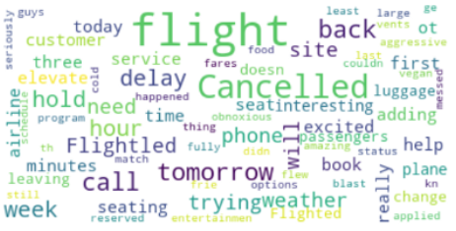

Tweet Classes
Positive Words
Negative Words
Neutral Words

Slide 10
Data Cleaning
For the purpose of this problem, we are only interested in the text of each tweet and its sentiment label. We will remove the extra features of our dataset, so we only have 2 columns in the end.
We chose not to clean the actual tweets themselves and not to remove twitter handles, special characters, and punctuation, because our RNN would automatically learn these variations and patterns.

Slide 11
Data Cleaning
We must transform our data for input into a RNN. Our text is initially coded as strings, so we have to convert it into a vector of integers. Ideally, we want each unique word in our dataset to have its own integer representation. Each tweet would then be represented as a vector with each element containing an integer that can be mapped to a specific word. This can be done using the Keras Tokenizer class.
This turns a piece of text into a sequence of integers with each integer being the index of a token in a dictionary. In general, tokenization is the process of converting sentences into words. We find that the vocabulary size of our dataset is 15,769 words

Slide 12
Data Cleaning
Another issue with our data is that each tweet is a different length, which means our vector lengths are also mismatched. To correct this, we first find the longest tweet which has a length of 30 words. Then we can pad each vector with 0’s so they all have the same dimensions
Next, we convert our sentiment labels to be one-hot encoded. This means our response for each tweet is now a row vector with 3 elements.
A train and test set was created using a 80:20 split. Our training data was then further reduced by 20% to create a validation set.

Slide 13
GloVe
GloVe is defined to be an “unsupervised learning algorithm for obtaining vector representations for words”. We downloaded data from the linked website and specifically use the 100-dimensional embeddings of 400k words from English Wikipedia in 2014.
The dimensions of the embedded matrix are our vocabulary size by 100, which is our embedding dimension as previously specified. Each row of this matrix is the GloVe vector representation of a word in our vocabulary.

Slide 14
Embedding Layer
The input dimension for this layer is our vocabulary size and the output is 100 for the embedding dimension. The weights are defined by the embedding matrix and we get trainable=False, because we wish to use the already pre-trained word embedding.
We want to avoid updating the pre-trained weights when training the model. The input length is 30, because we decided to pad all our sequences to this value to ensure all the vectors had the same length

Slide 15
General Architecture
The inputs for each of the following models are our training data which consists of 11,712 with 20% withheld for validation. Each one of these observations contains 30 “features” which correspond to each word in the tweet. Any 0’s indicate the absence of a word.
Each model ends with a dense layer with 3 nodes, because we have 3 possible labels: positive, neutral, or negative. Because we one-hot encoded our labels, we use softmax for this multiclass classification problem to get a probability for each class.

Slide 16
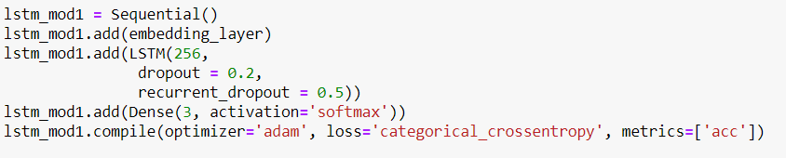
Simple LSTM with Dropout and High Dimensionality
This method contains one LSTM, one embedding layer, one softmax layer
The output dimension for the LSTM layer is 256 which means we increase the dimensionality from 100 which is the output from the embedding layer.

Slide 17
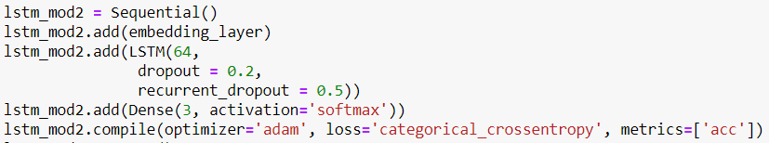
Simple LSTM with Dropout and Low Dimensionality
We set the number of units for our single LSTM layer to be 64. We note that the number of trainable parameters in the second model is significantly lower than that in the first model

Slide 18
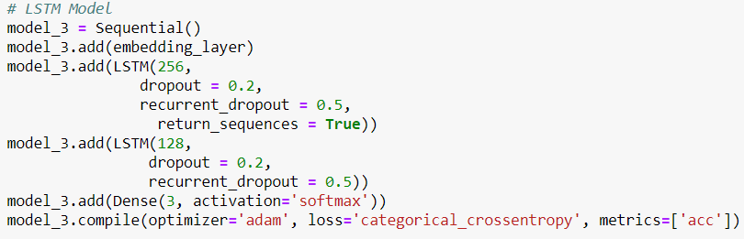
LSTM Layer Stacking
In addition to the first LSTM layer, a second LSTM layer with 128 units with 0.2 dropout and 0.5 recurrent dropout.

Slide 19
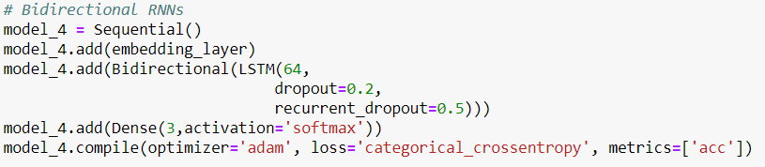
Bidirectional RNN
We note that using bidirectional layers greatly increase the number of parameters in the model, so we have to initially worry about overfitting. Therefore, in this case, we will only include one bidirectional layer with 64 units. We also use dropout and recurrent dropout at 0.2 and 0.5 respectively.

Slide 20
Thank You

